Slide 1
Lecture 1
Introduction to
Academic Writing
Exploring the features of
academic writing
Notes:
Writing Style
Plan English
Impersonal Writing Style
Personal Writing Style

Slide 2
What are the characteristics of academic writing?
Formal
Analytical
Clear
Concise
Accurate
Objective
Precise
Critical

Slide 3
Academic Writing Style
Formal English
Avoid
Slang - A few quid
Colloquial speech - They were just, kind of, walking around
Clichés - Pretty as a picture
Contraction - They couldn’t…
Phrases that sound like speech - This bit is really fascinating
Subjective descriptions - This ugly sculpture

Slide 4
Plan English
Avoid using jargon
Use everyday words when possible
Explain specialised words if they can’t be avoided
Write for your intended audience
Keep sentences short (under 20 words)
Avoid wordy phrases

Slide 5
Impersonal - Formal
Write in the third person, avoid “I”, “we” or “you”
Examples
It can be argued that ……
There are a number of issues with this ……

Slide 6
Personal - Formal
Writing in a personal way for a self reflection, writing about a case study or role play.
You can use “I” and “we”
Example
Upon reflection I have realised that …
My role in the scenario was …

Slide 7
Rewrite this sentence in a more academic style
I think the study by Smith (2019) is really good because it says that there is a link between what newspaper you read and the political party you vote for.
Smith (2019) argues that there is a relationship between the newspaper people read and the political party they vote for.

Slide 8
Tips!
Aim for clarity
Only use specialised vocabulary if you understand it
Be concise
Write in full sentences

Slide 9
Report or essay?
A Report | A Essay
Presents information | Presents an argument
Is meant to be scanned quickly by the reader | Is meant to be read carefully
Uses numbered headings, bullet points and so on | Rarely uses sub headings
Uses short concise sentences and paragraphs | Links sentences and paragraphs rather than using bullet points
Uses graphics such as charts and tables to present information | Rarely uses graphics
Often needs and abstract or executive summary | Will only use one if it is very long (a dissertations) or if it is requested specifically
Often followed by recommendations and or appendices | Rarely has a recommendations or appendices unless they are requested

Slide 10
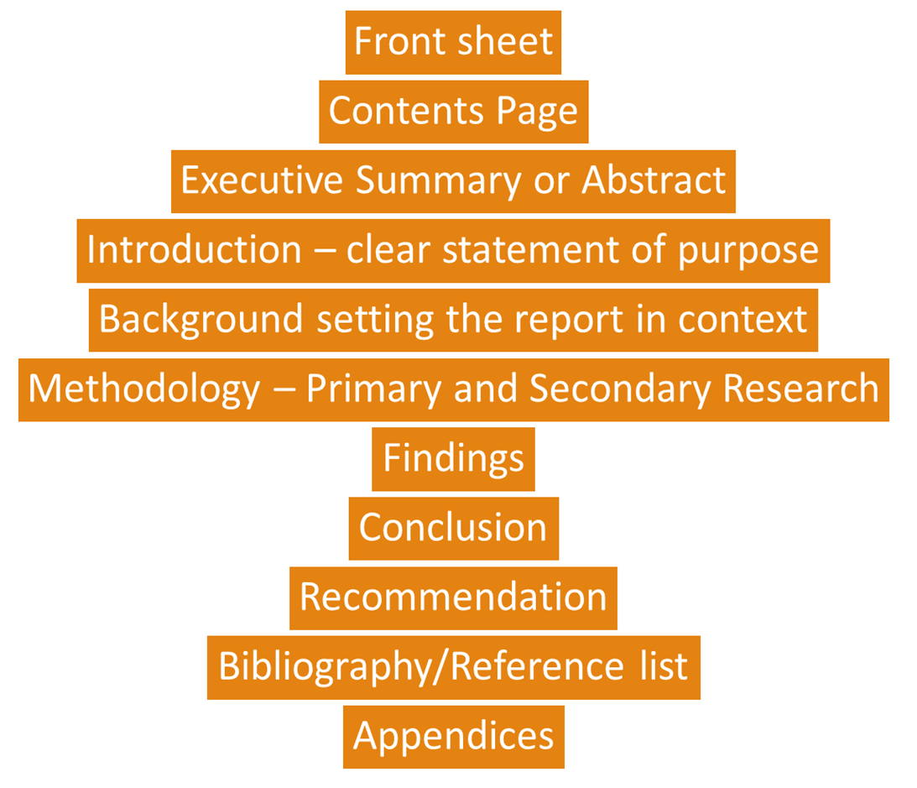
Example
Report Structure

Slide 11
Essay
Planning your essay
A liner plan or mind map?
The flow of the essay
How are you going to ensure that your arguments, evidence, conclusions and sections of your essay all flow together, and are not just a jumble of random points and words?
The logic of the essay
How are you going to ensure that your essay follows a logical structure through your separate points? Essays involve analysing along many strands so how are you going to group these strands?
The progression of the essay
How are you going to progress your arguments, conclusions and work through your associated research fields?

Slide 12
Stages
Choosing a title, question or have one set
Understanding the question and re-writing it in own words
Collecting and reviewing research
Planning your approach and main research areas
Writing the main body
Organising and writing the introduction
Organising the bibliography and citations/references
Revision and editing
Proof-reading
Writing conclusions

Slide 13
Useful online resources
Academic Phrasebank has commonly used phrasal elements in academic English http://www.kfs.edu.eg/com/pdf/2082015294739.pdf
The Open University has a great range of free resources online to help improve writing http://www2.open.ac.uk/students/skillsforstudy/
Grammar Girl is an online resource to explain everything from semi-colons to sentence structure. Quick and easy to use. http://www.quickanddirtytips.com/grammar-girl
A clever little online gadget that counts the frequency of words in a given body of text to highlight words which you overuse. Always helpful in extended academic writing. http://www.wordcounter.com/

